Slide 1
Spring Core
AMOL R PATIL - 9822291613PUNE

Slide 2


What is Spring ?
Spring Framework is a Java platform that provides comprehensive infrastructure support for developing Java applications.
Spring handles the infrastructure so you can focus on your application.

Slide 3
Spring Framework is a Java Platform that provides comprehensive infrastructure support for developing Java Applications
Spring enables you to build applications from “Plain old Java Objects” ( POJOs) and to apply enterprise services non-invasively to POJOs . This capability applies to the Java SE programming model to Full and partial Java EE
Spring is a lightweight framework. It can be thought of as a framework of frameworks because it provides support to various frameworks such as Struts, Hibernate, Tapestry, EJB, JSF, etc. The framework, in broader sense, can be defined as a structure where we find solution of the various technical problems.

Slide 4
Spring is known for its dependency injection and Inversion of Control (IoC) systems, which allow you to create large-scale, loosely-coupled applications with ease. Spring is especially suited for financial and enterprise applications due to its speed, security, and easy-to-build transaction systems. The top employers of Spring developers are Citibank, eBay, Visa, and J.P. Morgan
The Spring Framework is an application framework and inversion of control container for the Java platform.
The framework's core features can be used by any Java application, but there are extensions for building web applications on top of the Java EE (Enterprise Edition) platform.

Slide 5
What is Spring ?
The Spring Framework (Spring) is an open-source application framework that provides infrastructure support for developing Java applications
One of the most popular Java Enterprise Edition (Java EE) frameworks, Spring helps developers create high performing applications using plain old Java objects (POJOs).
A framework is a large body of predefined code to which developers can add code to solve a problem in a specific domain. There are many popular Java frameworks including Java Server Faces (JSF), Maven, Hibernate, Struts, and Spring.

Slide 6
Why Spring ?
Java programs are complex and feature many heavyweight components. Heavyweight means the components are dependent on the underlying operating system (OS) for their appearance and properties.
Spring is considered to be a secure, low-cost and flexible framework. Spring improves coding efficiency and reduces overall application development time because it is lightweight -- efficient at utilizing system resources -- and has a lot of support.
Spring removes tedious configuration work so that developers can focus on writing business logic. Spring handles the infrastructure so developers can focus on the application.

Slide 7
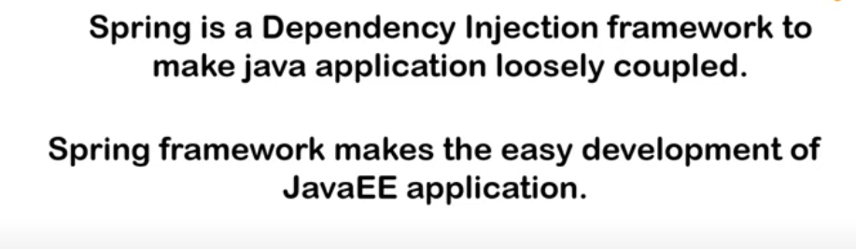

Slide 8
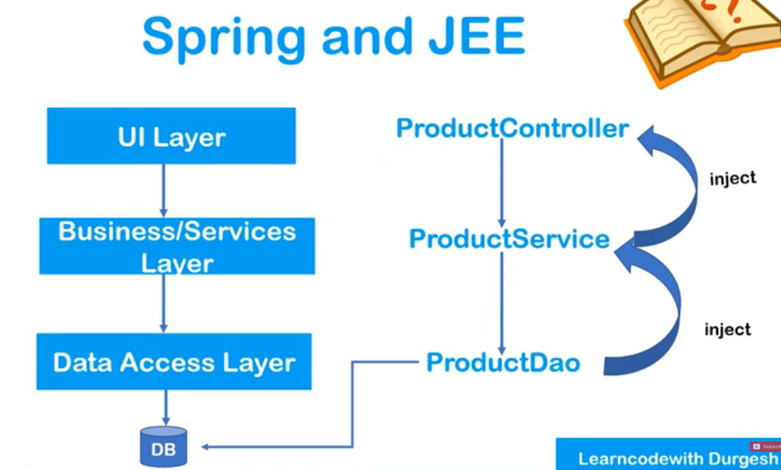

Slide 9
Coupling
A situation where an object can be used by another object is termed as coupling.
While creating complex application in java, the logic of one class will call the logic of another class to provide same service to the clients.
If one class calling another class logic, then it is called collaboration.
When one class is collaborating with another class then there exists tight-coupling between the two classes.

Slide 10
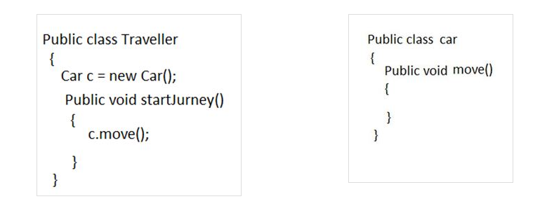
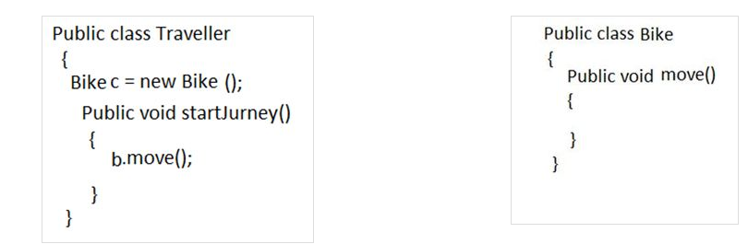
Tight Coupling

Slide 11
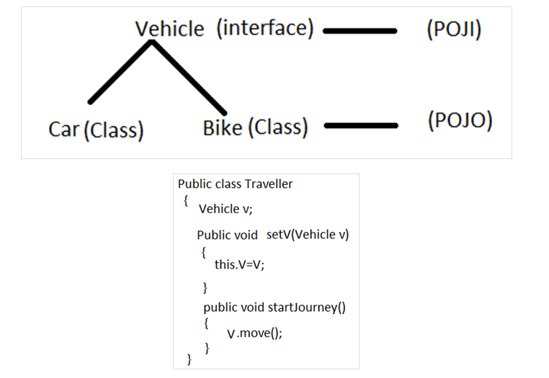
Loose Coupling
In Loose-Coupling, when one object is depending on another class object, some external entity will provide that dependency object to the main object that external object we call as a Container.
In order to get loose-coupling between objects the following two rules are required
The classes should follow
POJI/POJO model.
Apply dependency injection
mechanism.

Slide 12
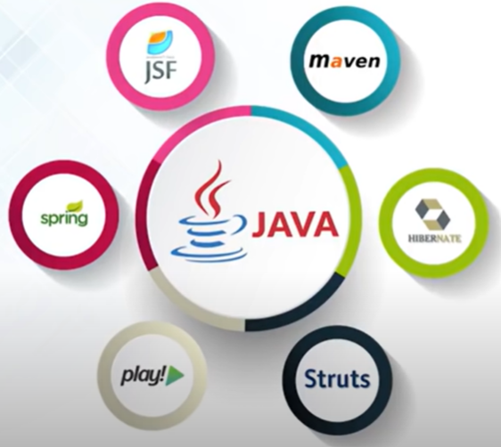
Java Frameworks

Slide 13
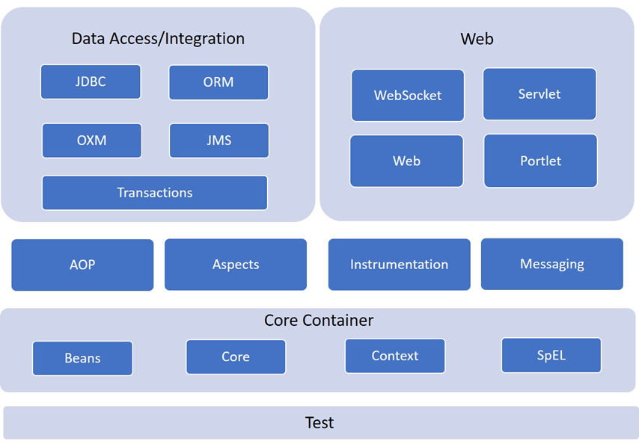
Spring Framework

Slide 14
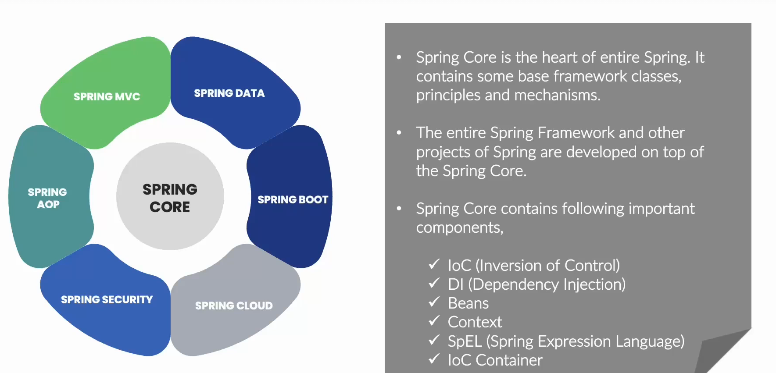

Slide 15
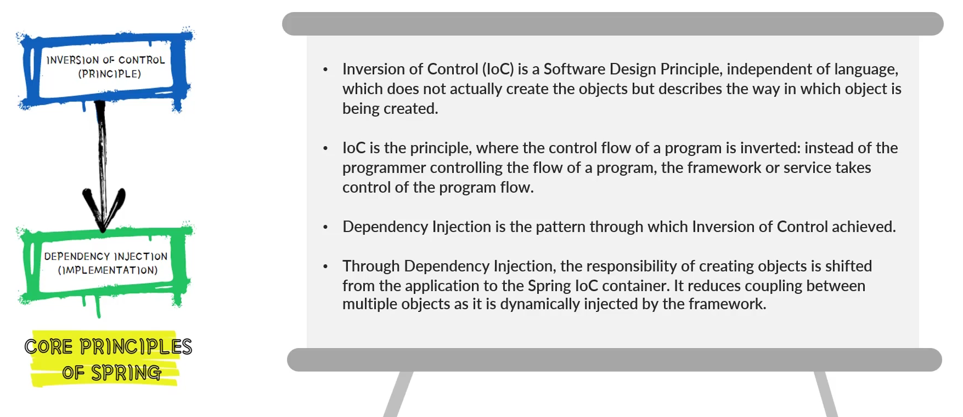

Slide 16
Spring Modules : Core
Spring Core Container: It is the core module of the Spring that provides containers like BeanFactory and ApplicationContext. The Core module provides all the primary component of the spring framework. It includes IoC (Inversion of Control) and Dependency Injection features
The SpEL module provides a powerful expression language for manipulating objects during execution.
Context is built on the basis of Beans and Core and allows you to access any object that is defined in the settings. The key element of the Context module is the ApplicationContext interface.
The Bean module is responsible for creating and managing Spring Beans - is application context structure unit
The Core module provides key parts of the framework including IoC and DI properties.

Slide 17
Spring Modules : Data Access
The Data Access and Integration layer consist of the JDBC, ORM, JDBC, OXM, JMS, and Transaction modules.
JDBC provides an abstract layer of JDBC and eliminates the need for the developer to manually register the monotonous code associated with connecting to the database.
Spring ORM provides integration with popular ORMs such as Hibernate, JDO, which are implementations of JPA.
The OXM module is responsible for linking the Object / XML - XMLBeans, JAXB, etc.
The JMS (Java Messaging Service) module is responsible for creating, sending and receiving messages.
Transaction: This module offers declarative and programmatic management method for implementing unique interfaces and for all types of POJOs (Plain Old Java Object )

Slide 18
Spring Modules : Web
The Web module provides functions such as downloading files, creating web application, rest web service etc.
Web-MVC contains a Spring MVC implementation for web applications.
Web-Socket provides support for communication between the client and the server, using Web-Sockets in web applications.
Web-Portlet provides MVC implementation with portlet environment

Slide 19
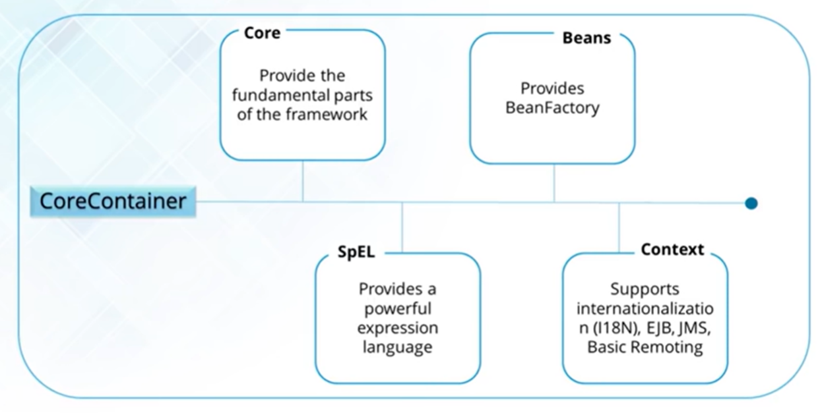

Slide 20
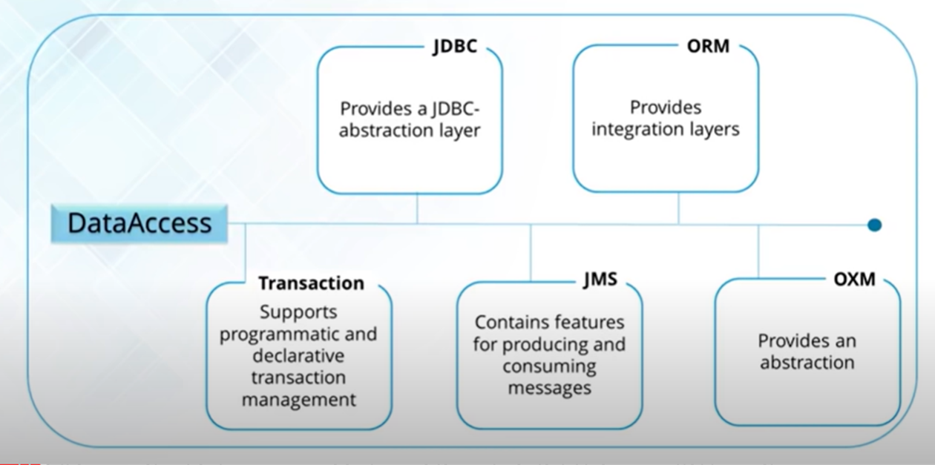

Slide 21
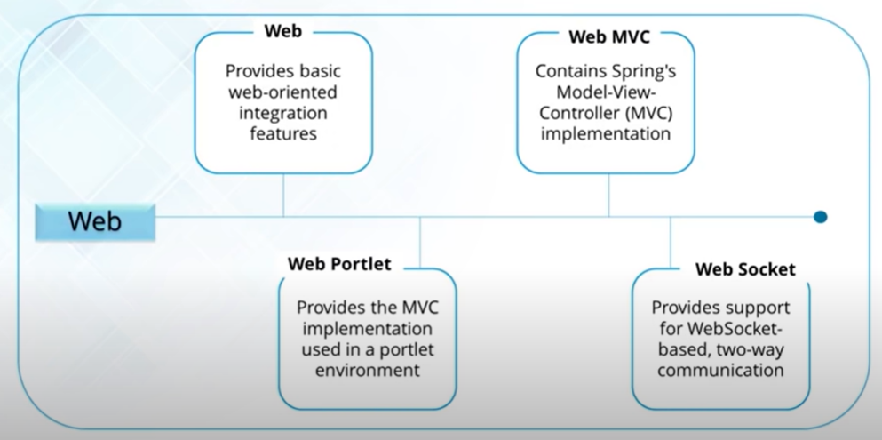

Slide 22
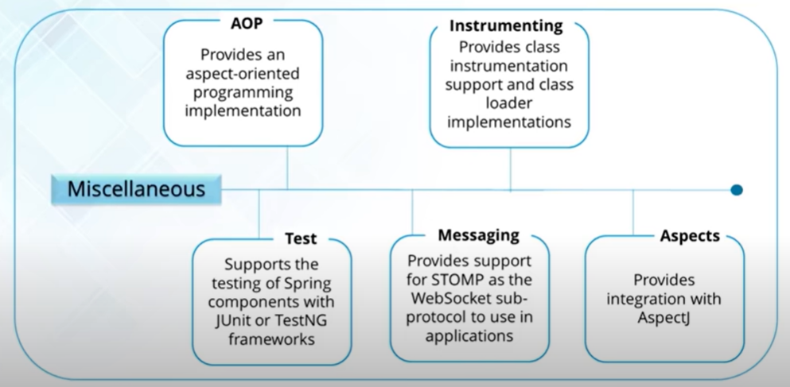

Slide 23
Spring Modules : miscellaneous
Aspect-Oriented Programming: This module enables implementing cross-cutting concerns inside the Spring framework such as transaction management, remote access, etc.
Data Access: It helps with working with database systems by using Java Database Connectivity (JDBC) and ORM (Object-Relational Mapping) tools.
Model View Controller: It is also known as the MVC model that helps to create web-based applications and RESTful Web services.
Authentication And Authorization: It is used to configure security processes within the framework by using the Spring Security (a sub-project of Spring).
Remote Management: It helps to configure Java objects for local or remote by using Java Management Extensions (JMX).
Testing: Testing module that helps in writing unit tests and integration tests.

Slide 24
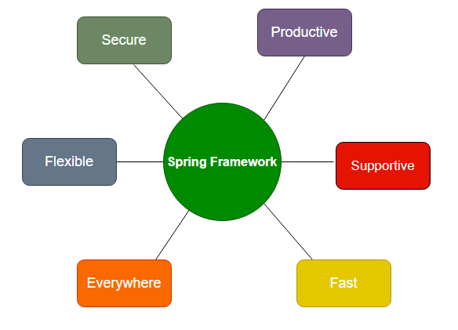
Spring Features
Spring’s core logic is dependency injection. Dependency injection is a programming pattern that allows developers to build more decoupled architectures. Dependency injection means that Spring understands the different Java annotations that a developer puts on top of classes. Spring knows that the developer wants to create an instance of a class and that Spring should manage it. Spring also understands the dependency and makes sure that all instances created have properly populated dependencies.
Bean - A Spring bean is an object that is instantiated, created, and managed by the IoC container. Beans are the backbone of an application.
Dependency injection - A programming design pattern that makes code loosely coupled, meaning that any change in the application of one, will not affect the other.
Inversion of control (IoC) - Taking control away from the class and giving it to the Spring Framework.

Slide 25
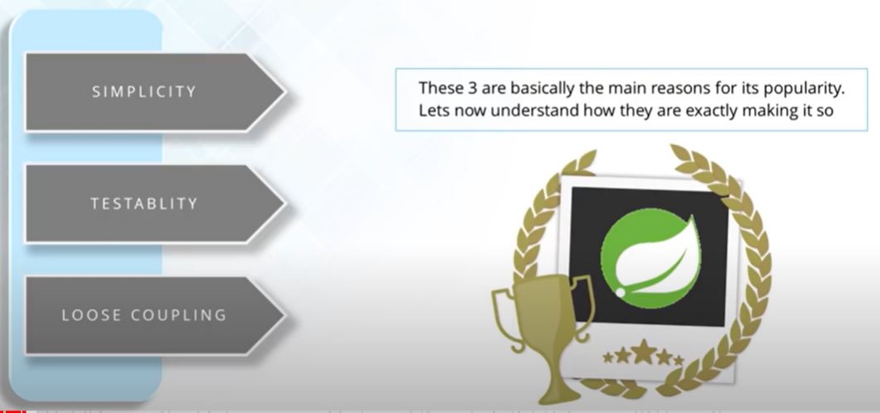
Spring Features

Slide 26
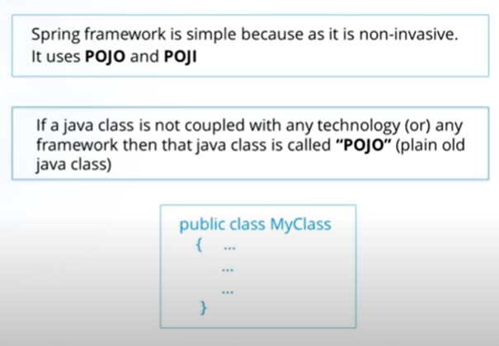
Spring Features Simplicity

Slide 27
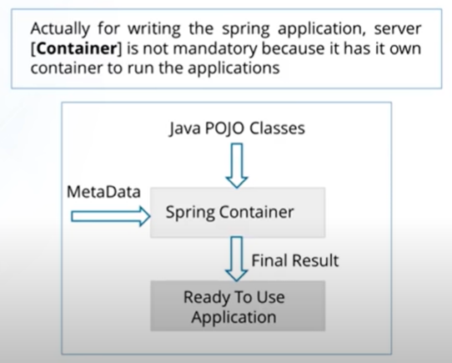
Spring Features Testability

Slide 28
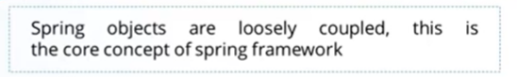
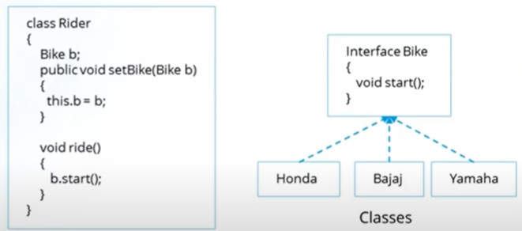
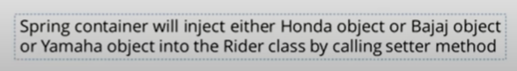
Spring Features Loose Coupling

Slide 29
Spring Advantages
Plain Old Java Object (POJO): Spring applications just use normal Java objects rather than servers or enterprise containers. This makes applications more lightweight.
Modularity IoC and MVC allows you to reuse components across your application without manually managing the dependencies of each
Strong support for Java ecosystem: Spring makes innovative uses of pre-existing technologies, such as ORM frameworks, JEE, and JDK timers
Scalable transactions: Spring offers a consistent, scalable transaction management interface for both local transactions and global transactions. This includes caching protocols.
Secure: Easy to implement security modules with authentication and validation features.
Flexible Configs: Can opt to use Java-based annotations or XML configuration
Inversion of Control (IoC): Shifts responsibility for dependencies from objects to the framework itself. Without IoC, each object must handle its own instance of the dependency. With IoC, the object simply lists that it needs a certain dependency and the framework configures and manages it automatically. This simplifies the app development process by consolidating the dependency system and reducing the workload on individual classes.

Slide 30
Spring Advantages
.
Aspect-Oriented Programming: Spring AOP allows you to have different class loaders to increase modularity and separate cross-cutting concerns.
Dependency Injection: The process Spring uses to automatically manage the dependencies of beans. Spring checks which beans are required for a particular bean to function and injects them as a dependency. Spring can perform dependency injection by using a constructor or by using a setter method.
Container Lifecycle Management: Automatically creates, manages, and configures application objects.
MVC support: Supports the MVC web architecture that separates functionalities between model, view, and controller layers.
Error Handling: Includes JDBC exception handling with an exception hierarchy

Slide 31
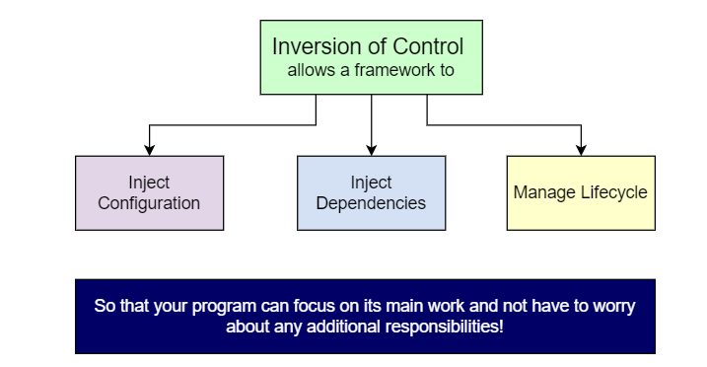
What is mean by Inversion of Control ?
Inversion of Control (IoC) is a design principle that allows classes to be loosely coupled and, therefore, easier to test and maintain.
IoC refers to transferring the control of objects and their dependencies from the main program to a container or framework.
IoC is a principle, not a design pattern – the implementation details depend on the developer. All IoC does is provide high-level guidelines.
Inversion of Control and Dependency Injection are often used interchangeably. However, Dependency Injection is only one implementation of IoC

Slide 32
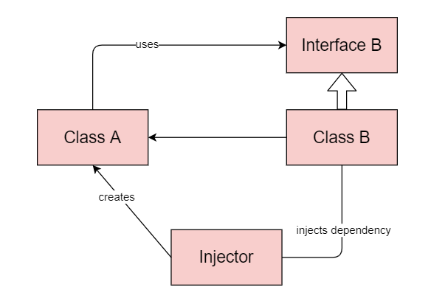
What is mean by Dependency Injection ?
Dependency injection is a technique that allows objects to be separated from the objects they depend upon. For example, suppose object A requires a method of object B to complete its functionality. Well, dependency injection suggests that instead of creating an instance of class B in class A using the new operator, the object of class B should be injected in class A using one of the following methods:
Constructor injection
Setter injection
Interface injection

Slide 33
Inversion of Control(IoC) is a principle by which the control of objects is transferred to a container or framework.
Dependency injection is a pattern through which IoC is implemented and the act of connecting objects with other objects or injecting objects into objects is done by container rather than by the object themselves.

Slide 34
Spring Container Responsibilities
The responsibilities of IOC container are:
Instantiating the bean
Wiring the beans together
Configuring the beans
Managing the bean’s entire life-cycle
The container gets its instructions on what objects to instantiate, configure, and assemble by reading configuration metadata. The configuration metadata is represented in XML, Java annotations, or Java code.

Slide 35
Spring Container Responsibilities
Spring IoC Container is mainly responsible for implementing Inversion of Control (IoC) i.e., to achieve loose coupling between the classes by creating the objects & injecting them dynamically during the run time.
Spring IoC Containers helps in instantiating the class & creating the object, configuring the object, assembling and managing the dependencies between the objects.
The information required for creating, configuring & assembling the objects is obtained by reading the XML Configuration file or scanning the Spring Java Annotations used in the project.

Slide 36
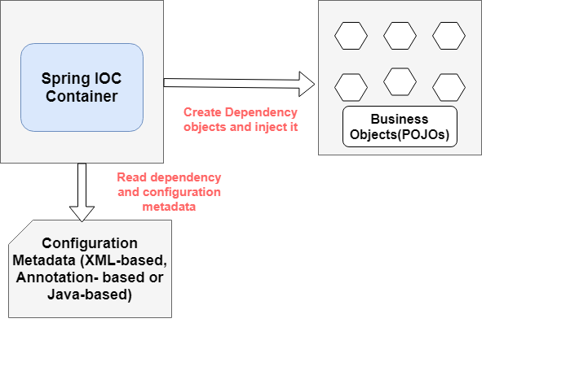
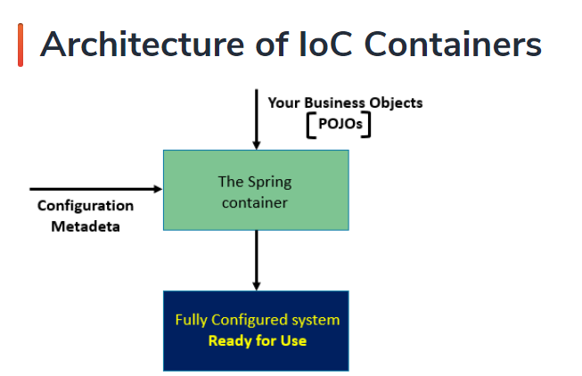

Slide 37
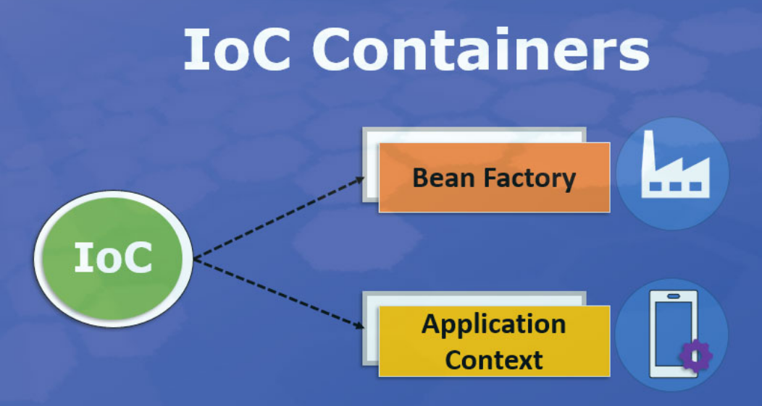
One main between BeanFactory and ApplicationContext is that BeanFactory only instantiates bean when we call getBean() method while ApplicationContext instantiates singleton bean when the container is started, It doesn't wait for getBean() method to be called.

Slide 38
What is Configuration Metadata ?
Configuration metadata represents how you, as an application developer, tell the Spring container to instantiate, configure, and assemble the objects in your application.
Three ways we can supply Configuration Metadata to Spring IoC container
XML-based configuration
Annotation-based configuration
Java-based configuration

Slide 39
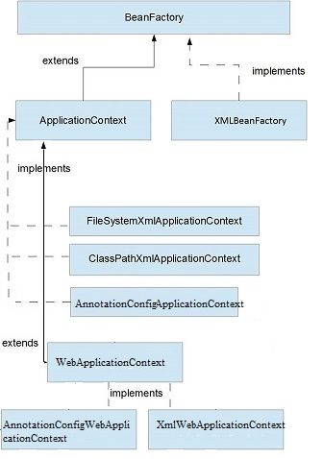
Types of Containers
The org.springframework.beans
and org.springframework.context
packages are the basis for Spring Framework’s
IoC container.
Spring framework provides two distinct types of containers.
BeanFactory container
ApplicationContext container

Slide 40
BeanFactory Vs. ApplicationContext
BeanFactory instantiates a bean when you call the getBean() method while ApplicationContext instantiates a Singleton bean as soon as the container starts.
BeanFactory supports lazy loading unlike ApplicationContext that support default eager loading.
BeanFactory doesn’t provide support for internationalization, but ApplicationContext provides support for it.
XMLBeanFactory implements BeanFactory whereas FileSystemXmlApplicationContext , ClassPathXmlApplicationContext and AnnotationConfigWebApplicationContex
implements ApplicationContext

Slide 41
BeanFactory | ApplicationContext
It is a fundamental container that provides the basic functionality for managing beans. | It is an advanced container that extends the BeanFactory that provides all basic functionality and adds some advanced features.
It is suitable to build standalone applications. | It is suitable to build Web applications, integration with AOP modules, ORM and distributed applications.
It supports only Singleton and Prototype bean scopes. | It supports all types of bean scopes such as Singleton, Prototype, Request, Session etc.
It does not support Annotations. In Bean Autowiring, we need to configure the properties in XML file only. | It supports Annotation based configuration in Bean Autowiring.
This interface does not provides messaging (i18n or internationalization) functionality. | ApplicationContext interface extends MessageSource interface, thus it provides messaging (i18n or internationalization) functionality.
BeanFactory does not support Event publication functionality. | Event handling in the ApplicationContext is provided through the ApplicationEvent class and ApplicationListener interface.
In BeanFactory, we need to manually register BeanPostProcessors and BeanFactoryPostProcessors. | The ApplicationContext automatically registers BeanFactoryPostProcessor and BeanPostProcessor at startup.
BeanFactory will create a bean object when the getBean() method is called thus making it Lazy initialization. | ApplicationContext loads all the beans and creates objects at the time of startup only thus making it Eager initialization.
BeanFactory interface provides basic features only thus requires less memory. For standalone applications where the basic features are enough and when memory consumption is critical, we can use BeanFactory. | ApplicationContext provides all the basic features and advanced features, including several that are geared towards enterprise applications thus requires more memory.

Slide 42
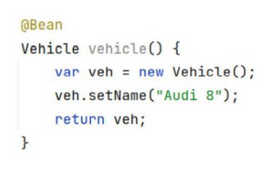
Adding New Bean using @Bean
Spring @Bean Annotation is applied on a method to specify that it returns a bean to be managed by Spring context. Spring Bean annotation is usually declared in Configuration classes methods.
In this case, bean methods may reference other @Bean methods in the same class by calling them directly.

Slide 43
@Bean Attributes
value – The name(s) that the bean will have. The default is the name of the @Bean annotated method
name – This is exactly the same as value
autowireCandidate – Defaults to true, specifies if other beans can autowire this bean
initMethod – The method to be called during the initialization of the bean
destroyMethod – The method to be called when the application context closes

Slide 44
@Component Annotation
The @Component annotation indicates that an annotated class is a "component". Such classes are considered as candidates for auto-detection when using annotation-based configuration and classpath scanning.
In short, @Component is a class level annotation. During the component scan, Spring Framework automatically detects classes annotated with @Component
@ComponentScan configures which packages to scan for classes with annotation configuration. We can specify the base package names directly with one of the basePackages or value arguments (value is an alias for basePackages):

Slide 45
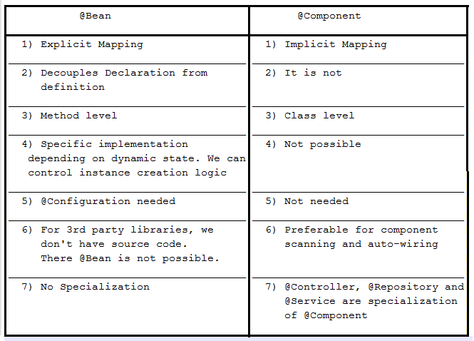
@Component Vs. @Bean

Slide 46
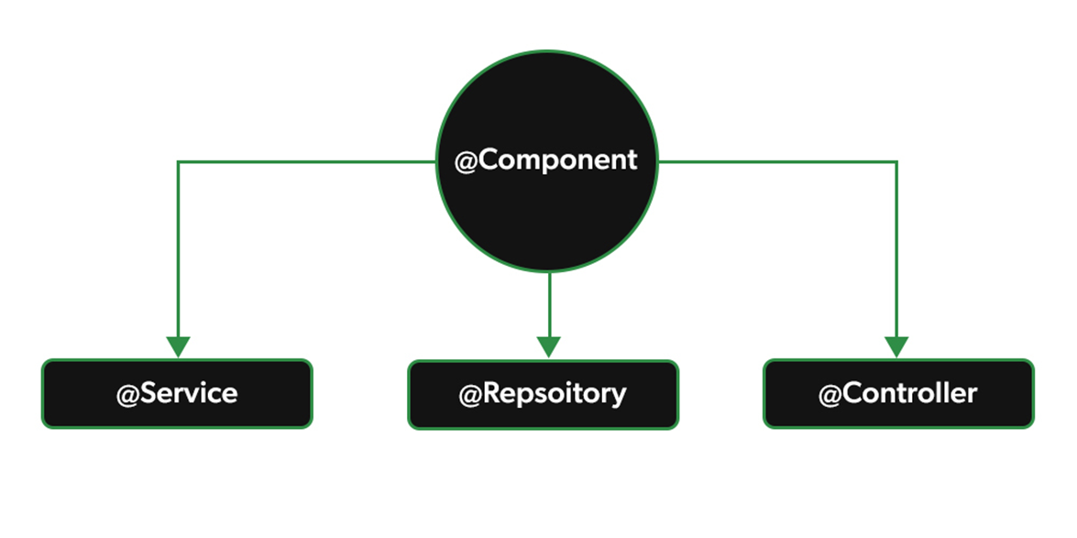
Stereotype Annotations
@Service: We specify a class with @Service to indicate that they’re holding the business logic. Besides being used in the service layer, there isn’t any other special use for this annotation. The utility classes can be marked as Service classes.
@Repository: We specify a class with @Repository to indicate that they’re dealing with CRUD operations, usually, it’s used with DAO (Data Access Object) or Repository implementations that deal with database tables.
@Controller: We specify a class with @Controller to indicate that they’re front controllers and responsible to handle user requests and return the appropriate response. It is mostly used with REST Web Services.

Slide 47
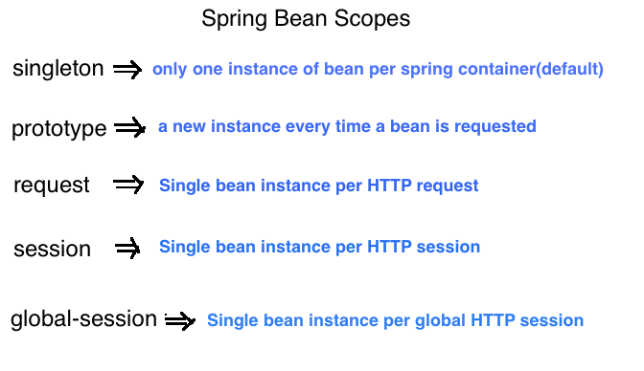
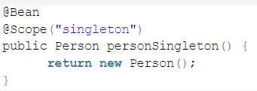
Bean Scopes

Slide 48
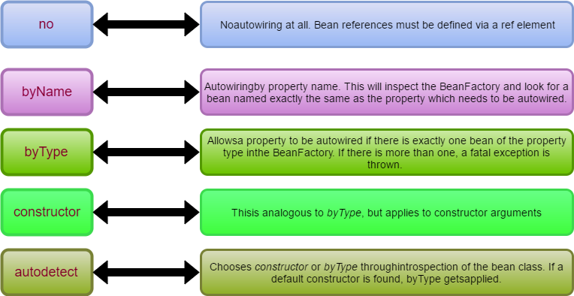
Spring Bean XML Autowiring Types

Slide 49
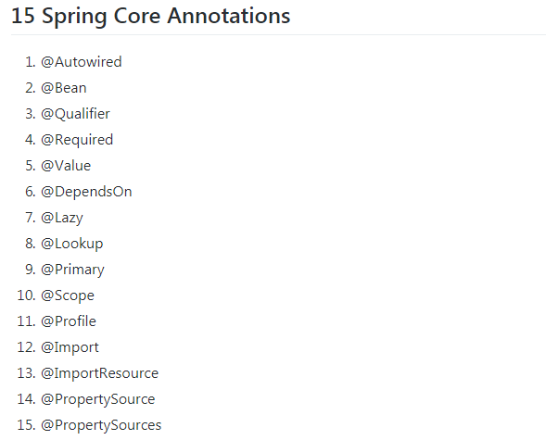
Spring Core Annotations

Slide 50
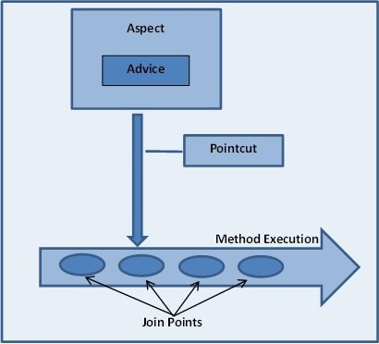
Spring AOP

Slide 51
Spring AOP
Joinpoint: is a point of execution of the program, such as executing a method or handling an exception. In Spring AOP, a joinpoint always represents a method execution. Joinpoints define the points in your application at which you can insert additional logic using AOP.
Advice: is the code that is executed at a particular joinpoint. There are many types of advice, such as before, which executes before the joinpoint, and after, which executes after it.
Aspect: is the combination of advices and pointcuts encapsulated in a class.
Pointcut: is a predicate or expression that matches joinpoints.
Weaving: is the process of inserting aspects into the application code at the appropriate point. AspectJ supports a weaving mechanism called loadtime weaving (LTW), in which it intercepts the underlying JVM class loader and provides weaving to the bytecode when it is being loaded by the class loader.
Target: is the object whose execution flow is modified by an AOP process. Often you see the target object referred to as the advised object.
Spring uses the AspectJ pointcut expression language by default.

